Slide 1

Time Management
Anand Walser

Slide 2
Learning objective
Understanding the importance of time management
Time management techniques

Slide 3

The Three Aspects of Time
Biological: Pertaining to bodily functions.
Social: Pertaining to self, family and society.
Professional: Pertaining to professional activities/time spent at work.

Slide 4
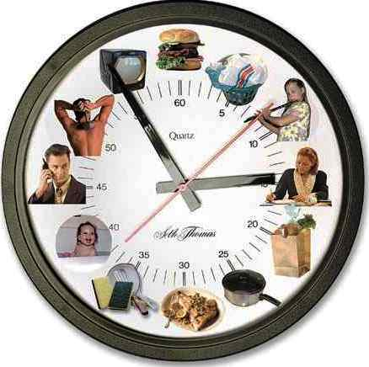
Biological Time
Adopt the golden mean of moderation among
Sleep
Food
Ablutions / Calls of nature
Sex / Recreation
Physical Exercise

Slide 5
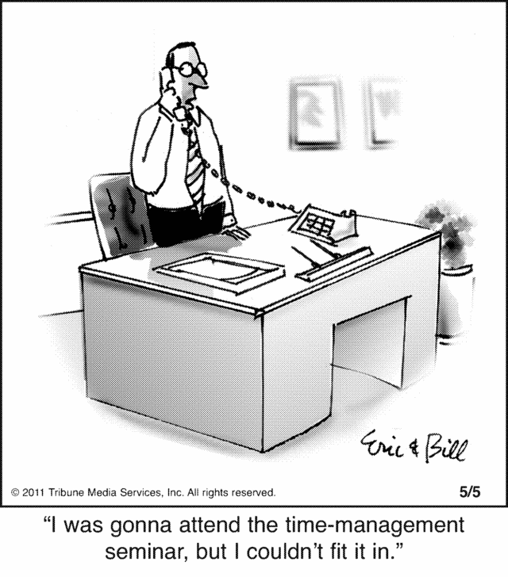
Social Time
Self Time or Self Development Time
Family Time
Social Time

Slide 6
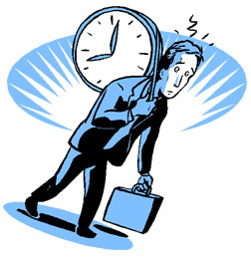
Professional Time
Aim is to optimally utilise the time available.
Maximise productivity and self satisfaction.
Avoid Time Wasters.
Infructuous meetings.
Poor communication [including unnecessary mobile phone calls].
Unwanted visitors
Disorganised work

Slide 7
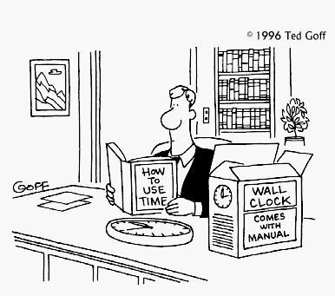
Two hours wasted per day
Messy desk
Can’t find things
Miss appointments
Unprepared for meetings
Tired/unable to concentrate

Slide 8
Importance of time management
Time management is an essential skill for employment, and equally important in gaining a good degree.
The basic principles are simple:
You should direct your effort appropriately, that is, towards the things that are most important.
You should direct your effort efficiently, that is, maximise what is achieved by the expenditure of time and energy.
You should reduce time wastage.

Slide 9
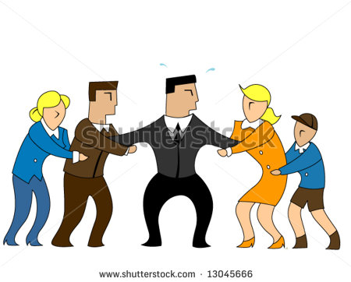
Being successful doesn’t make you manage your time well.
Managing your time well makes you successful.

Slide 10
Goals, Priorities, and Planning
Why am I doing this? What is the goal?
Why will I succeed?
What happens if I chose not to do it?
Doing things right vs. doing the right things
100 things to do in my life
Notes:
Doing the right things is more important than doing things right

Slide 11

Time management for students
Time management = study success
How much time spent on studying
How well you use that time
Time = choice
Using time effectively gives you choice to do:
In-depth research
Revising what you have learnt
Preparing for exams
Being with family
Enjoying social life

Slide 12
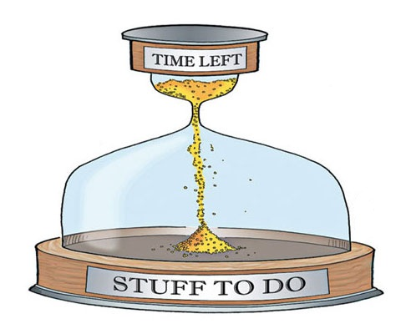
Planning
Failing to plan is planning to fail
Plan Each Day, Each Week, Each Semester
You can always change your plan, but only once you have one!

Slide 13
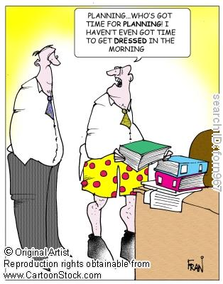
TO DO Lists
Break things down into small steps
Like a child cleaning his/her room
Do the ugliest thing first

Slide 14
Covey’s four-quadrant TODO
Due Soon
Not Due Soon
Important
Not
Important

Slide 15
Covey’s four-quadrant TODO
Due Soon
Not Due Soon
1 | 2
3 | 4
Important
Not
Important

Slide 16
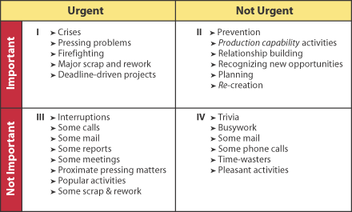

Slide 17
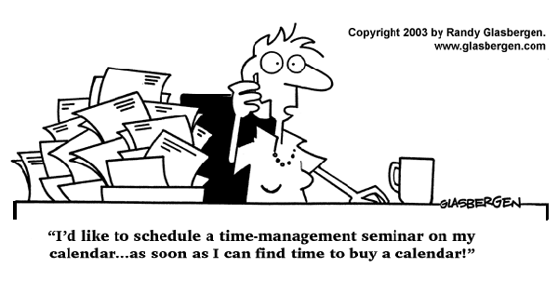
Scheduling Yourself
You don’t find time for important things, you make it
Everything you do is an opportunity cost
Learn to say “No”

Slide 18
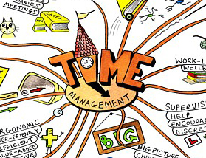
Everyone has Good and Bad Times
Find your creative/thinking time. Defend it ruthlessly, spend it alone, maybe at home.
Find your dead time. Schedule meetings, phone calls, and mundane stuff during it.

Slide 19
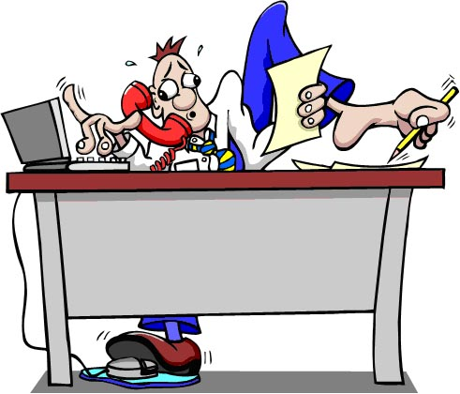
Cutting Things Short
“I’m in the middle of something now…”
Start with “I only have 5 minutes” – you can always extend this
Stand up, stroll to the door, complement, thank, shake hands
Clock-watching; on wall behind them

Slide 20
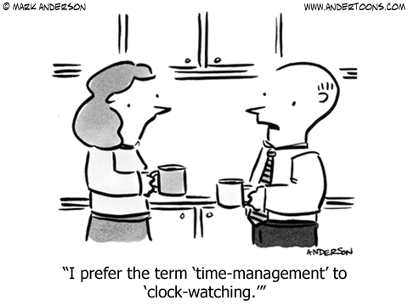
Time Journals
It’s amazing what you learn!
Monitor yourself in 15 minute increments for between 3 days and two weeks.
Update every ½ hour: not at end of day

Slide 21
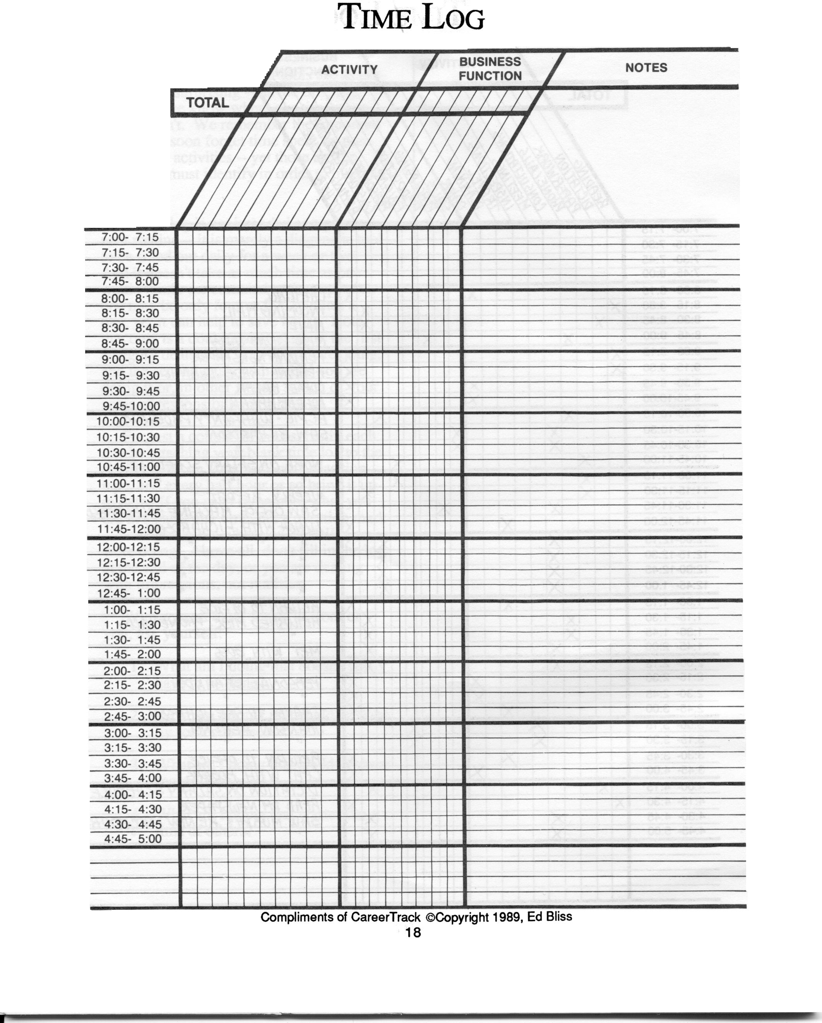

Slide 22
Using Time Journal Data
What doesn’t need to be done?
What can someone else do?
What can I do more efficiently?
How am I wasting other people’s time?

Slide 23
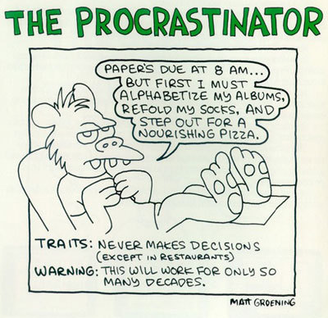
Avoiding Procrastination
Doing things at the last minute is much more expensive than just before the last minute
Deadlines are important: establish them yourself!

Slide 24
Comfort Zones
Identify why you aren’t enthusiastic
Fear of embarrassment
Fear of failure
Sometimes all you have to do is ask!

Slide 25
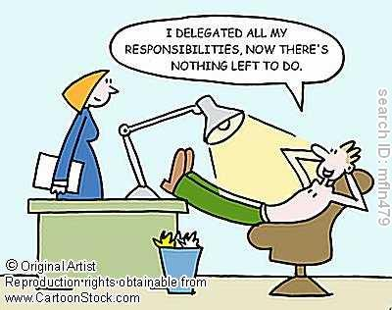
Delegation
No one is an island
You can accomplish a lot more with help

Slide 26
Delegation is not dumping
Give authority with responsibility.
Do the worst job yourself
Treat your people well
Staff and secretaries are your lifeline; they should be treated well!
Notes:
VACCUM

Slide 27
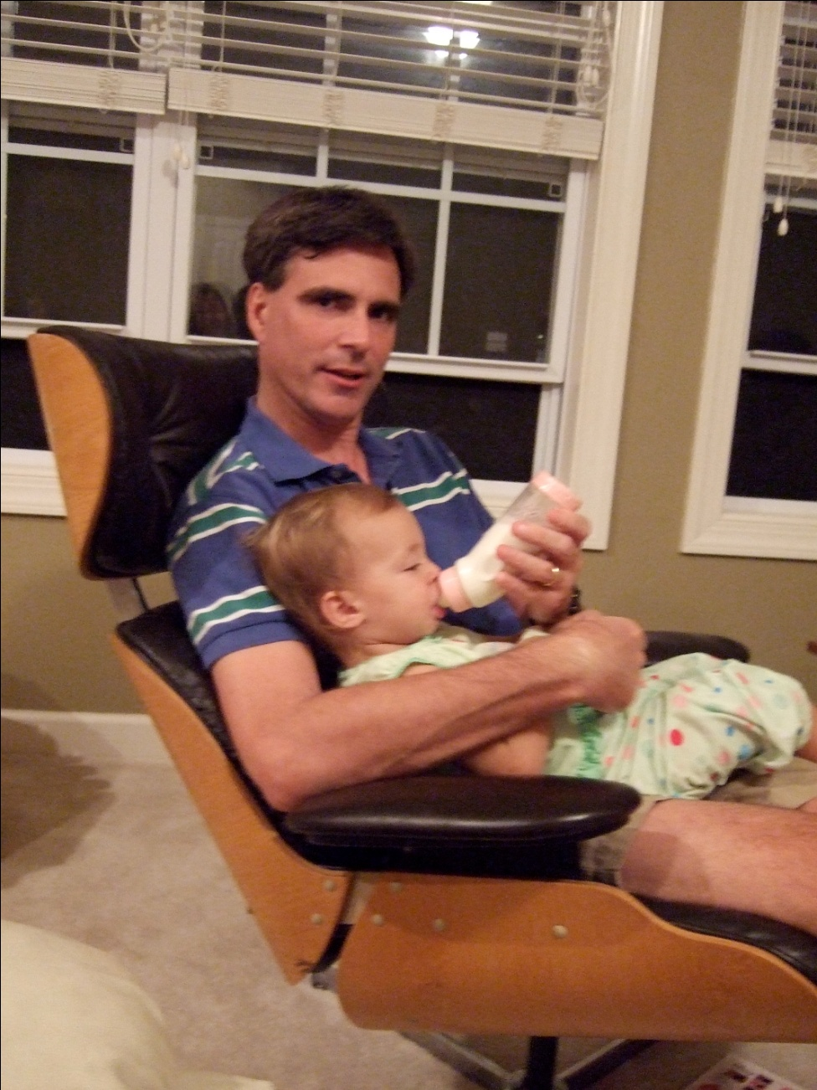
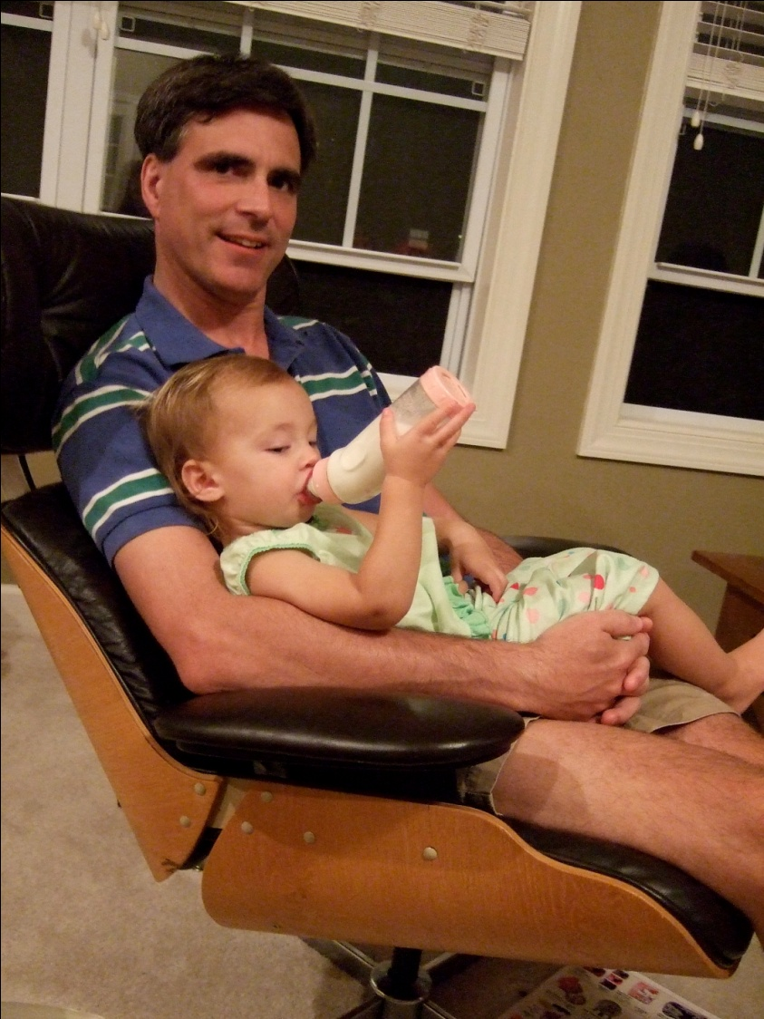
Never too Early to Delegate

Slide 28

10 good steps to time management
1 Be systematic in your time management
2 Find out your time requirements
3 Clarify how you use your time currently
4 Decide how you want to spend your time
5 Prioritise what is most important
6 Plan what you will do when
7 Do it, keeping to your plan
8 Apply time management techniques
9 Manage distractions and procrastination
10 Monitor Keep checking it is all working

Slide 29

Time saving strategies
Save time writing notes – laptop
Save time copying files – could services
Save time looking for your notes
Save time writing references
Save time thinking – carry a small notebook
Save time reading – smart reader

Slide 30
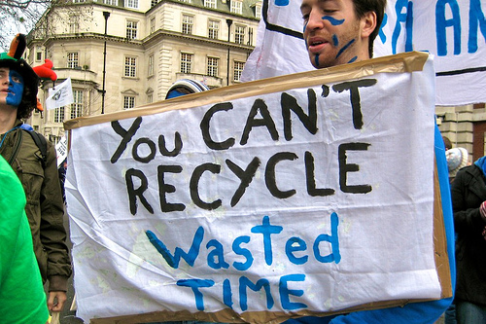
General Advice
If you haven’t got time to do it right, you don’t have time to do it wrong.
Notes:
Don’t polish the underside of the bannister

Slide 31
References
Cameron, S. (2016) The Business Student’s Handbook, 6th edn. Harlow: Pearson Education Limited
Cottrell, S. (2013) The Study Skills Handbook, 4th edn. London: Palgrave Macmillan Ltd.

